Slide 1
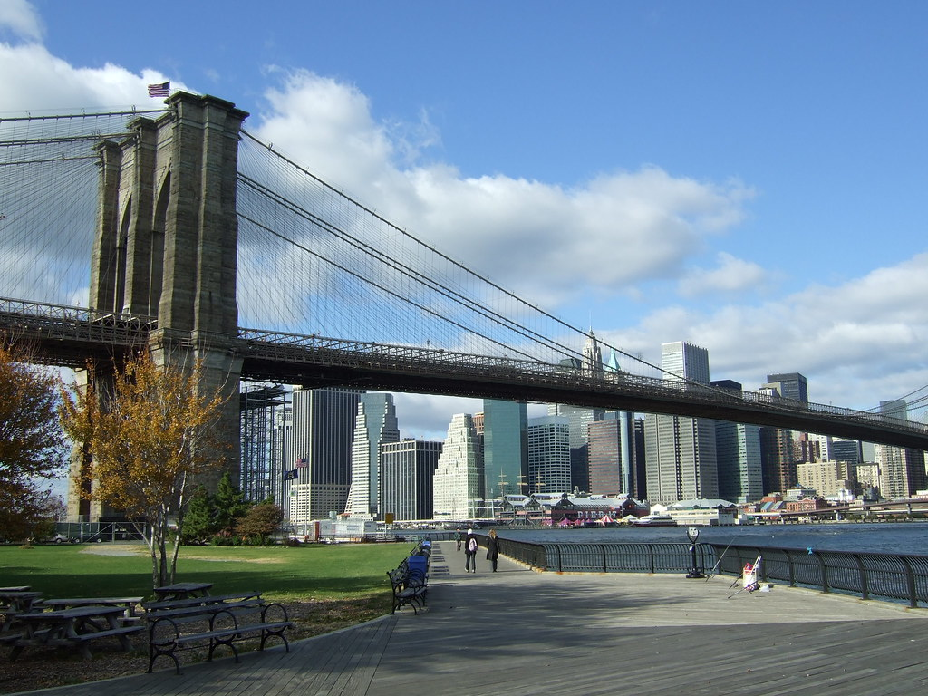

Brooklyn Bridge
By Zeke

Slide 2
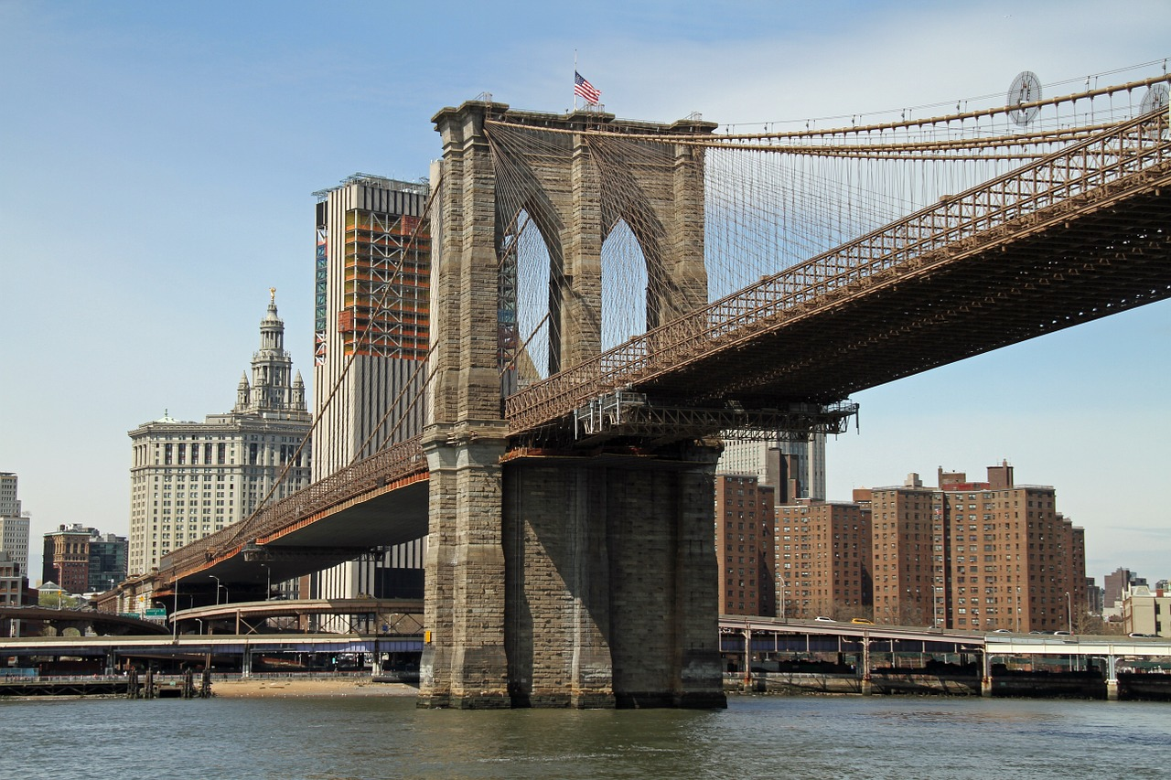
Length, Height, and Wideness
The Brooklyn Bridge is 5,989 feet long ,132 feet above water, and 85 feet wide

Slide 3
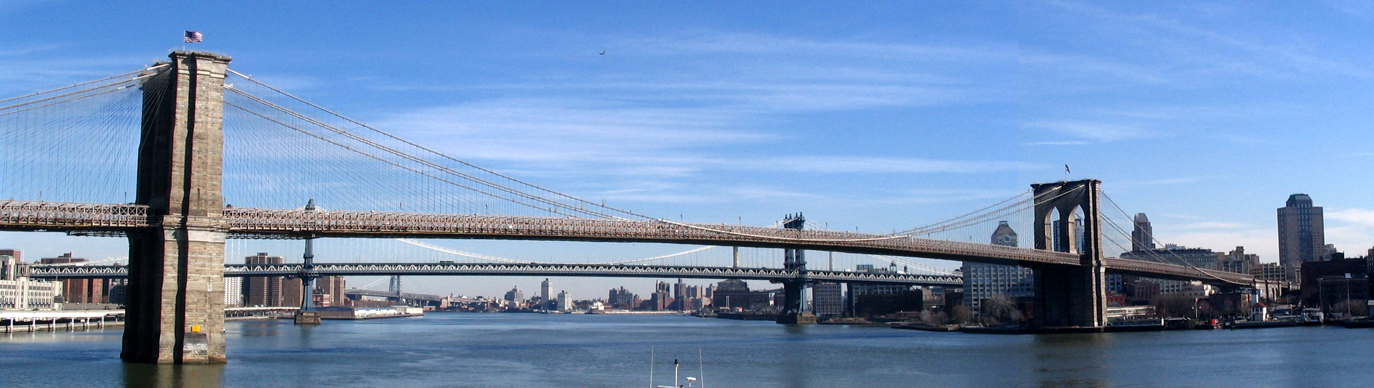
Interesting Facts about the Brooklyn Brige
Connects Manhattan and Brooklyn, goes over east river, 24 people died during construction,150,000 vehicles cross everyday, has granite towers and steel cables, and workers paid pennies a day.

Slide 4
Location
The Brooklyn Bridge is in New York City

Slide 5


Brooklyn vs.Chengyang
The Brooklyn Bridge is 1,760.443 meters larger than the Chengyang Bridge.

Slide 6
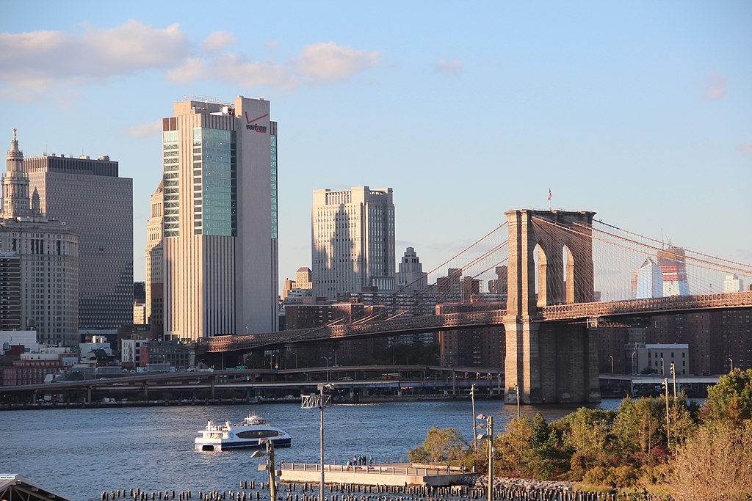
Researched and Produced by Zeke at Buck Lake in Tallahassee Florida

